Slide 1
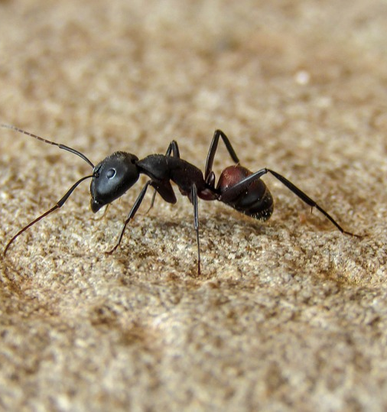

Back to home in desert
Overview
Paper of M. Collett
Concept of global and local vector
Model of the ant
Conducted experiments
Our simulation
Conclusion
Source: https://www.antbites.net/adult-ants-fourth-stage-of-the-ant-life-cycle/

Slide 2
Paper of M. Collett et al.
Written in 1998
Navigation of desert ants
M. Collett, T. S. Collett, S. Bisch, R. Wehner

Slide 3
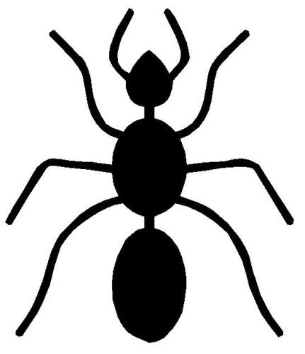
Global and local vector
Problem: no visible landmarks in desert
Solution: path integration
Sun as compass

Slide 4
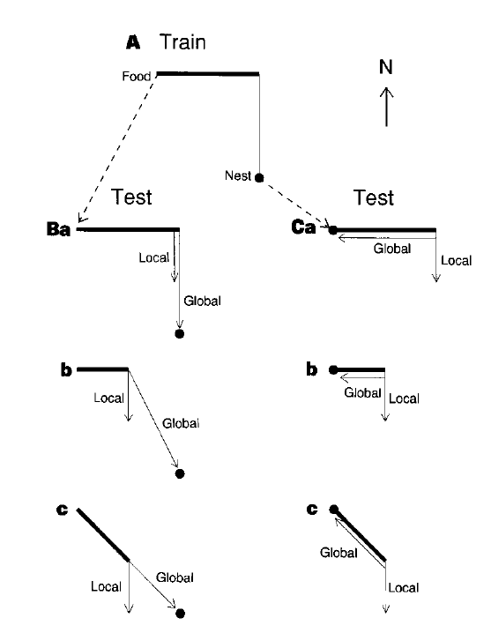
Conducted experiments
Ants get trained first
Ants picked up on way home

Slide 5
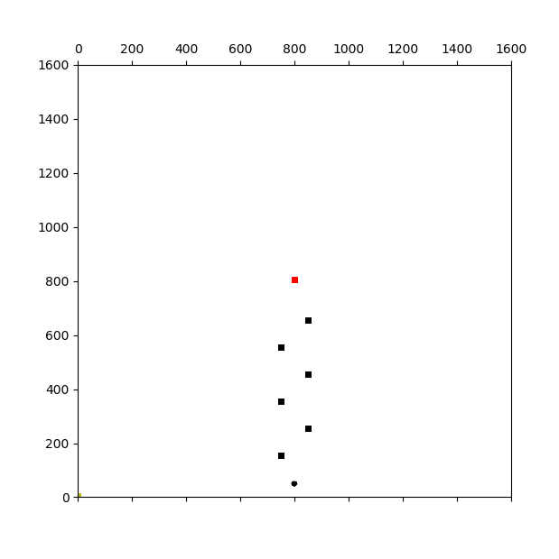
Conducted experiments II
Black cylinders als landmarks

Slide 6
Model of the ant

